Slide 1
File Server Migration

Slide 2
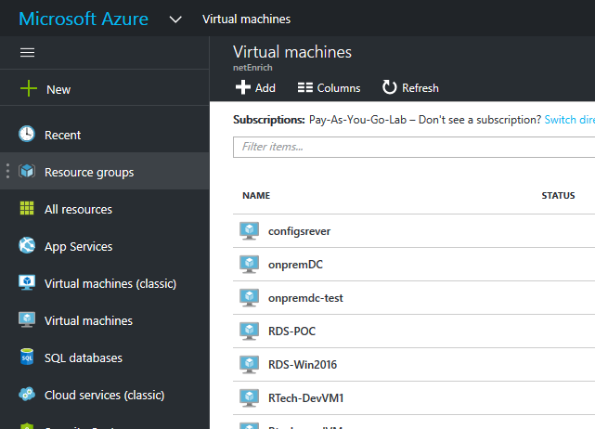
Create VM in Azure

Slide 3
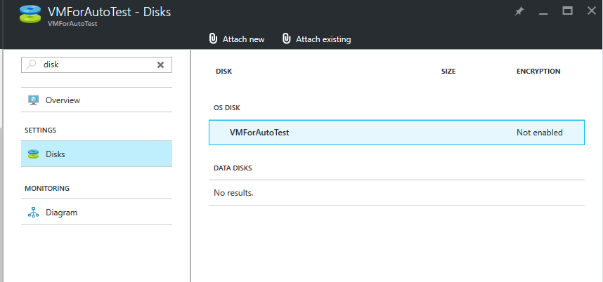
Add Data Disk to VM

Slide 4
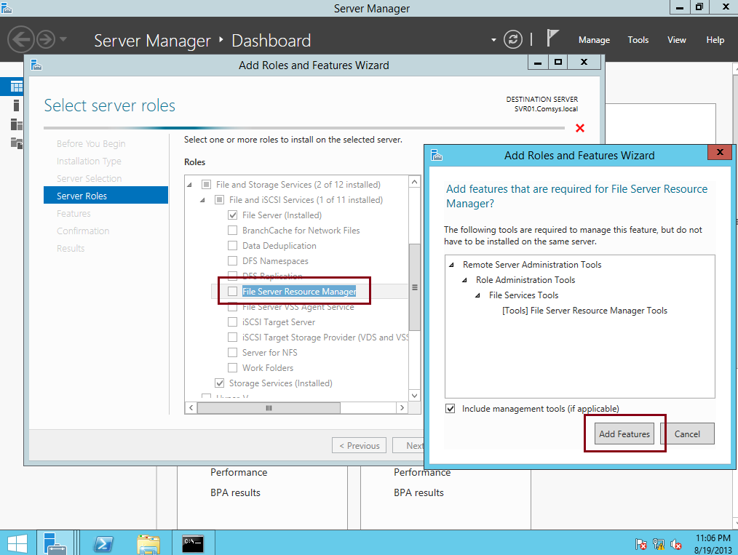
Install File Server Role

Slide 5
Steps to Create File Server Share

Slide 6
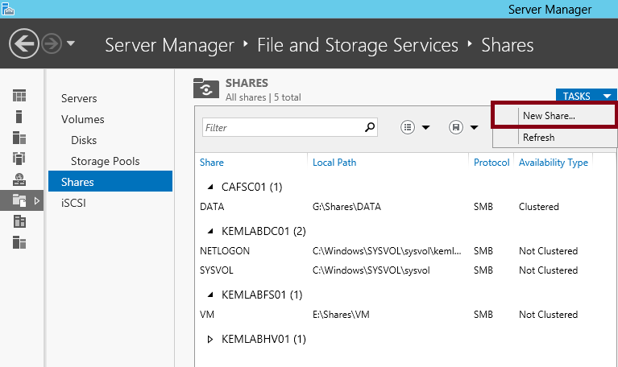
Step 1

Slide 7
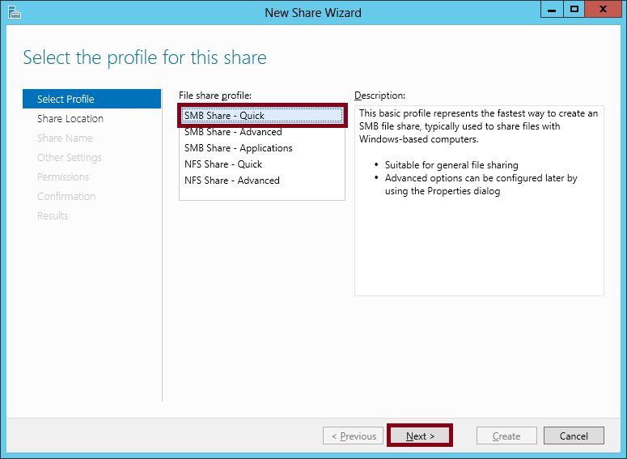
Step 2

Slide 8
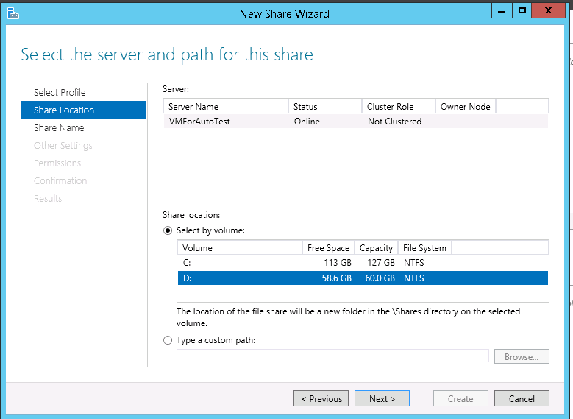
Step 3

Slide 9
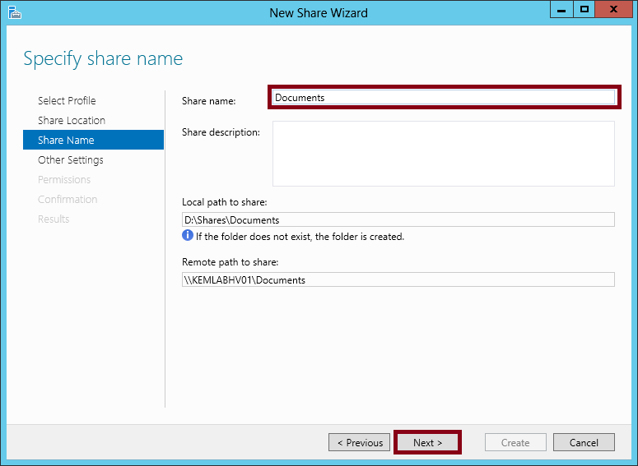
Step 4

Slide 10
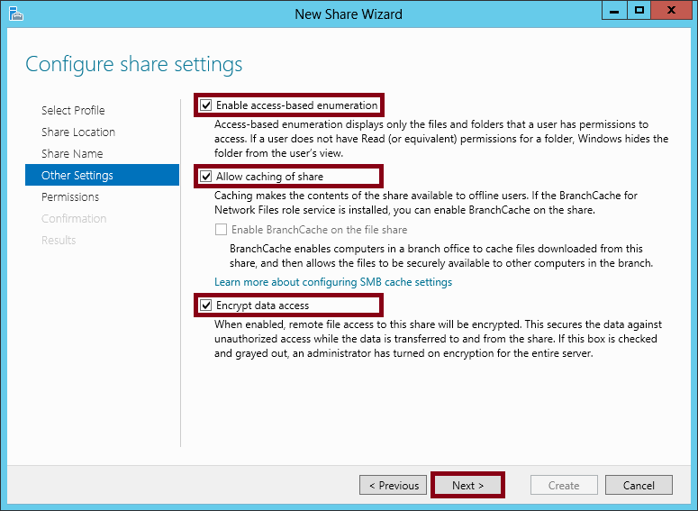
Step 5

Slide 11
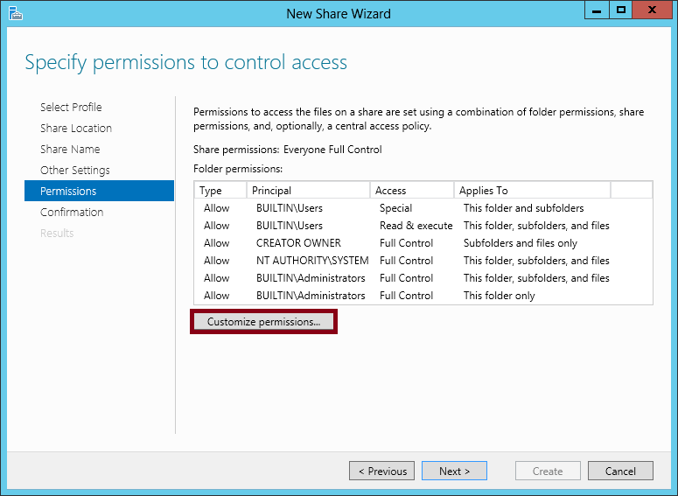
Step 6

Slide 12
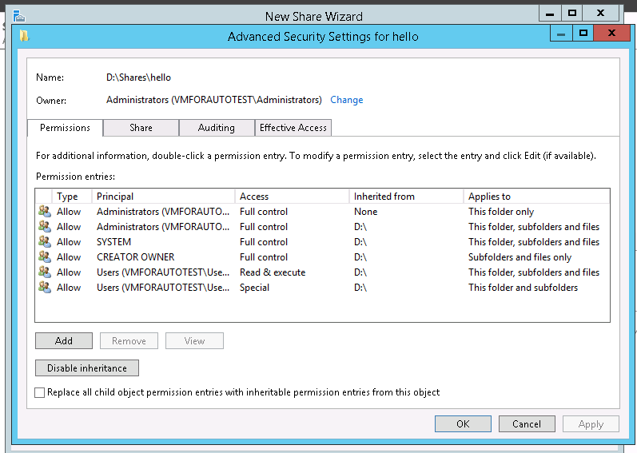
Customize Permissions

Slide 13
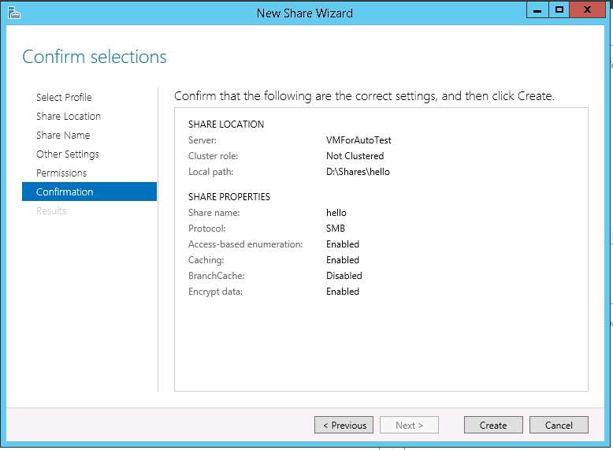
Step 7

Slide 14
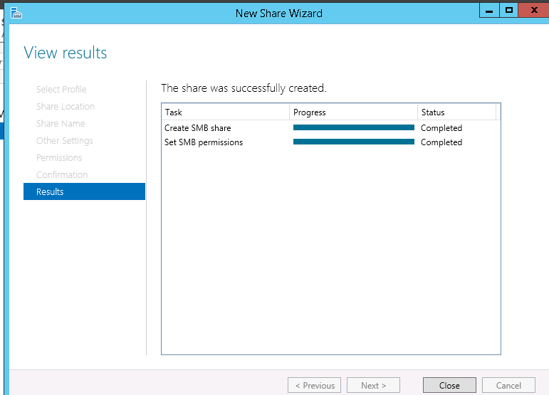
Step 8

Slide 15
Transfer on-premise files to File Server Shared Folder

Slide 16
Connect to the File Share using “net use” command
net use \\publicip\sharename /user:Devicename\username

Slide 17
Use “robocopy” to copy the files
robocopy SourceFolderPath DestinationShareFolder

